Slide 1
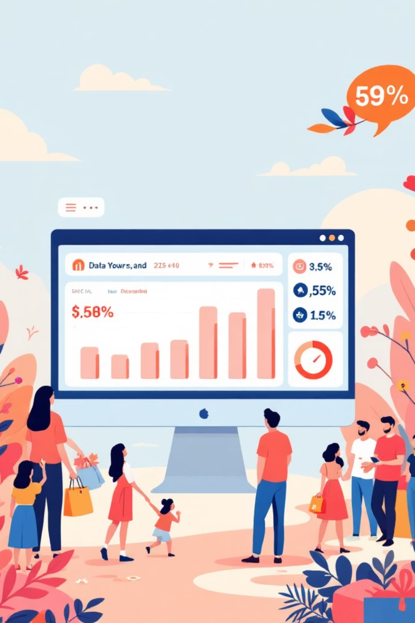
Customer Shopping Behavior Analysis
Analysis of 3,900 purchases to reveal spending patterns, segments, product preferences, and subscription behavior to guide strategy.

Slide 2

Dataset Snapshot
Scope
Key Features
Missing Data
3,900 rows · 18 columns
Demographics, purchase details, behavior, subscription, shipping
37 nulls in Review Rating

Slide 3

Data Preparation (Python)
Load & Inspect
Imported with pandas; used df.info() and describe()
Clean
Imputed Review Rating nulls with category median
Standardize
Renamed columns to snake_case
Engineering
Added age_group and purchase_frequency_days

Slide 4

Database Integration & Redundancy Check
Connected cleaned DataFrame to Microsoft SQL Server for SQL analysis
Checked redundancy: dropped promo_code_used (redundant with discount_applied)

Slide 5
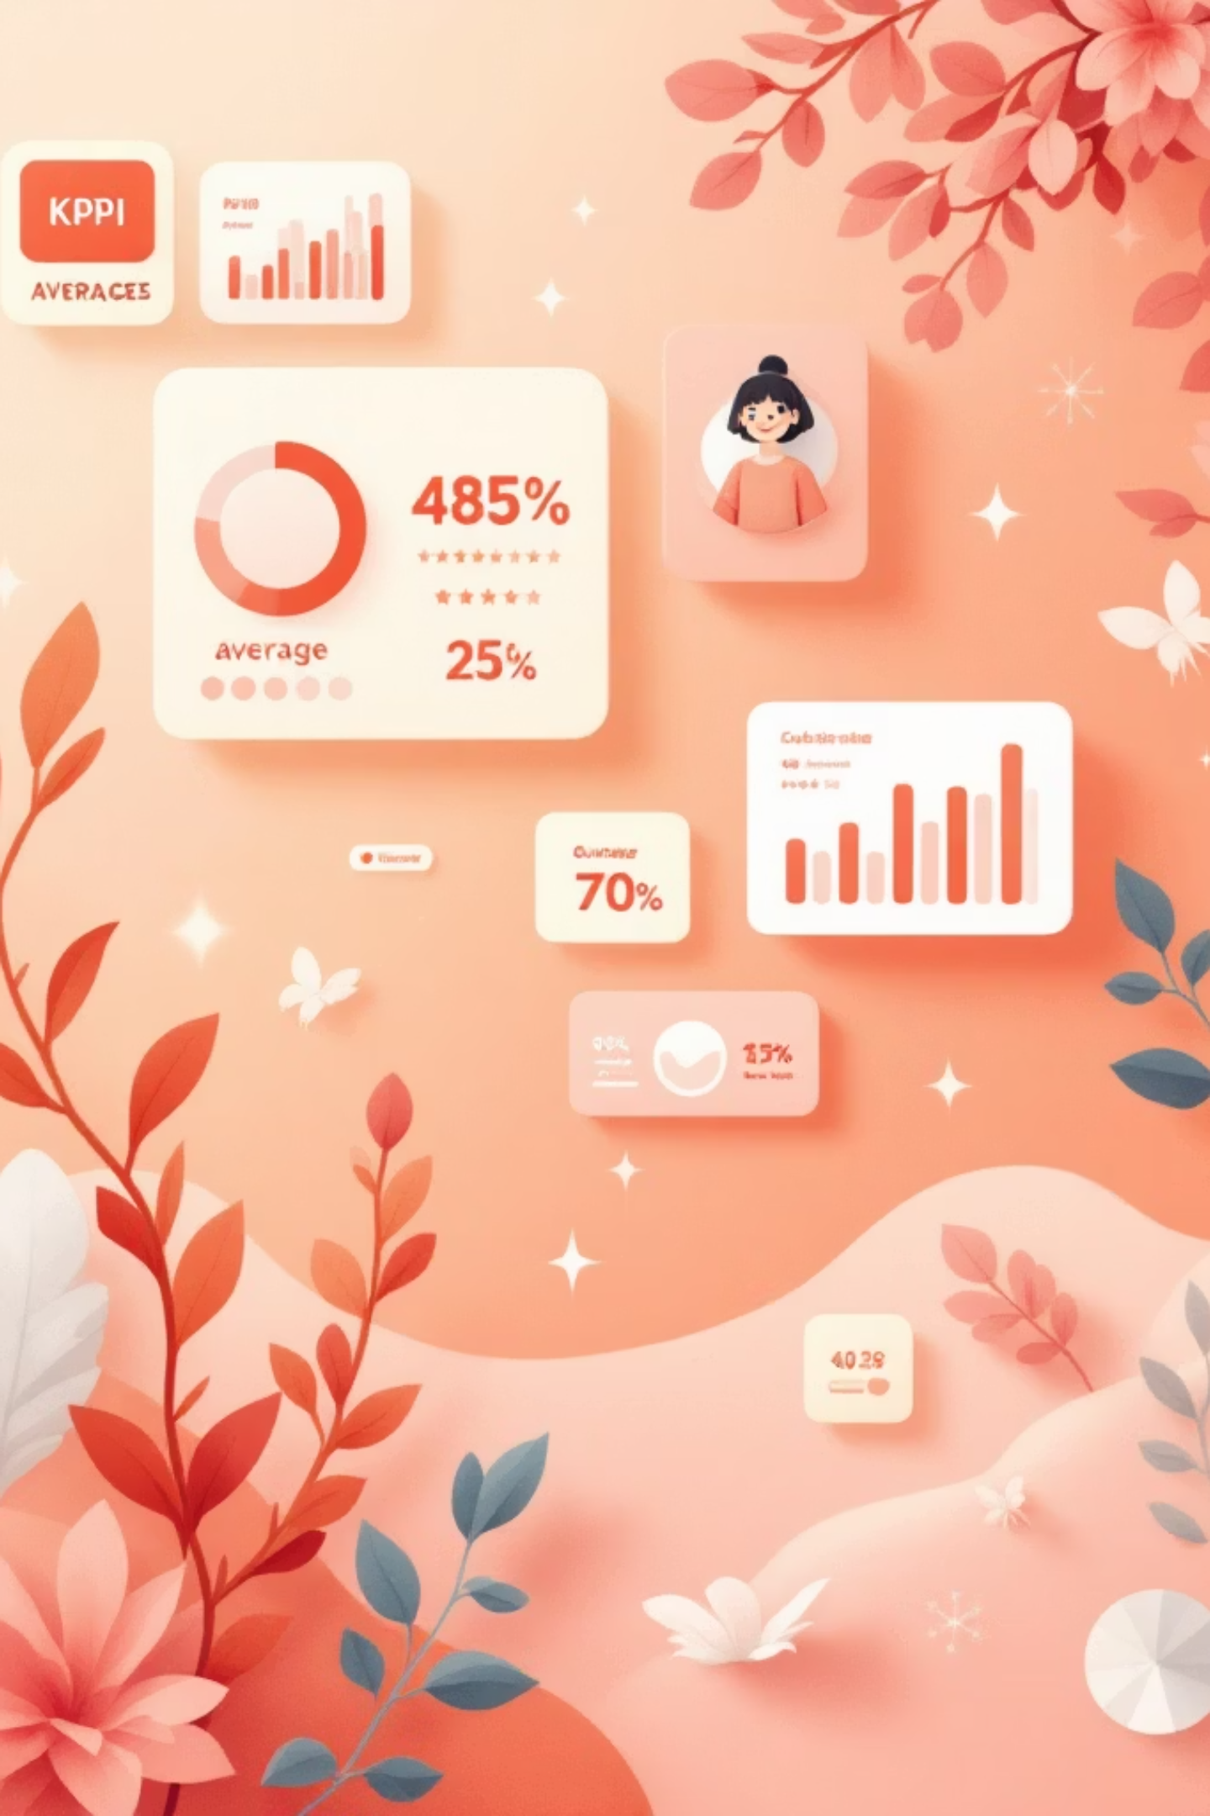
High-Level Metrics
3.9K
$59.76
3.75
Customers
Avg Purchase
Avg Rating
Number of purchase records
Average purchase amount
Average review rating
27%
Subscribers
Share of customers with subscription

Slide 6

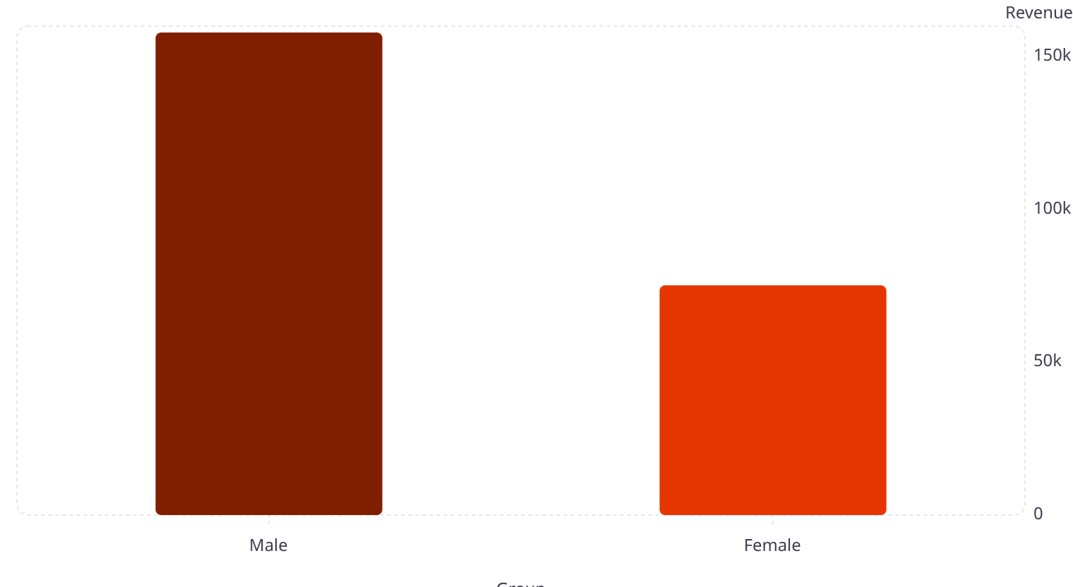
Revenue & Subscription Insights (SQL)
Subscribers: 1,053 avg spend $59.49 (total $62,645). Non-subscribers: 2,847 avg $59.87 (total $170,436). Consider ARPU and retention strategies.

Slide 7

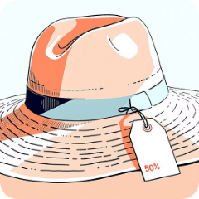
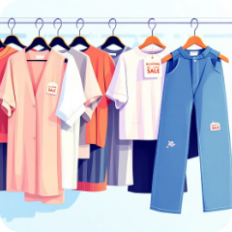
Product & Discount Patterns
Top Rated Items
Discount-Dependent
Top Sellers by Category
Gloves (3.86), Sandals (3.84), Boots (3.82), Hat (3.80), Skirt (3.78)
Highest discount rates: Hat 50%, Sneakers 49.66%, Coat 49.07%, Sweater 48.17%, Pants 47.37%
Clothing: Blouse, Pants, Shirt. Accessories: Jewelry, Sunglasses, Belt.

Slide 8

Customer Segments & Loyalty
Repeat buyers (>5 purchases): Mostly non-subscribers (2,518 no vs 958 yes). Focus loyalty programs to convert Returning → Loyal and support subscription growth.
Segments
Loyal: 3,116 · Returning: 701 · New: 83

Slide 9
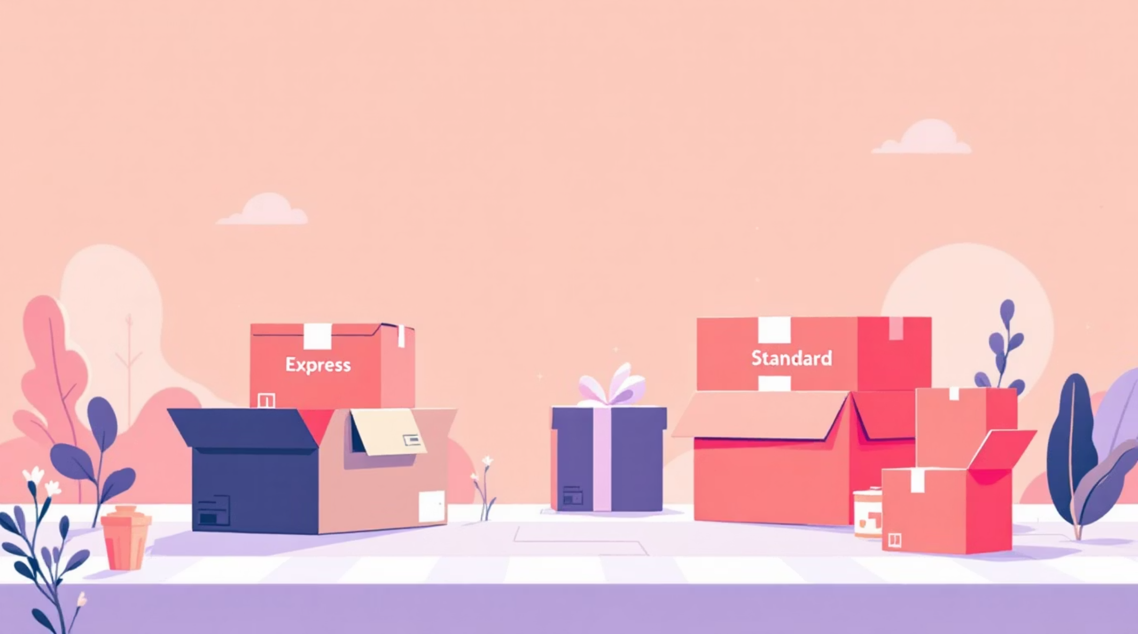
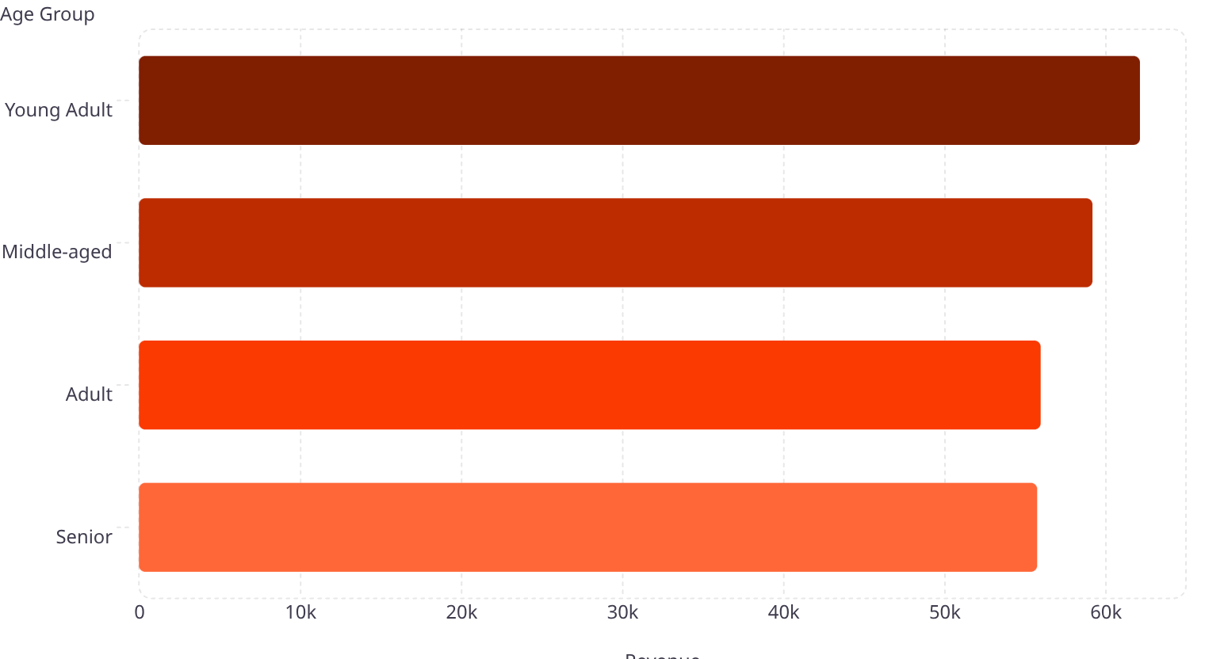
Age & Shipping Insights
Shipping comparison: Standard avg $58.46 vs Express avg $60.48. Target marketing to high-revenue age groups and express-shipping users.

Slide 10
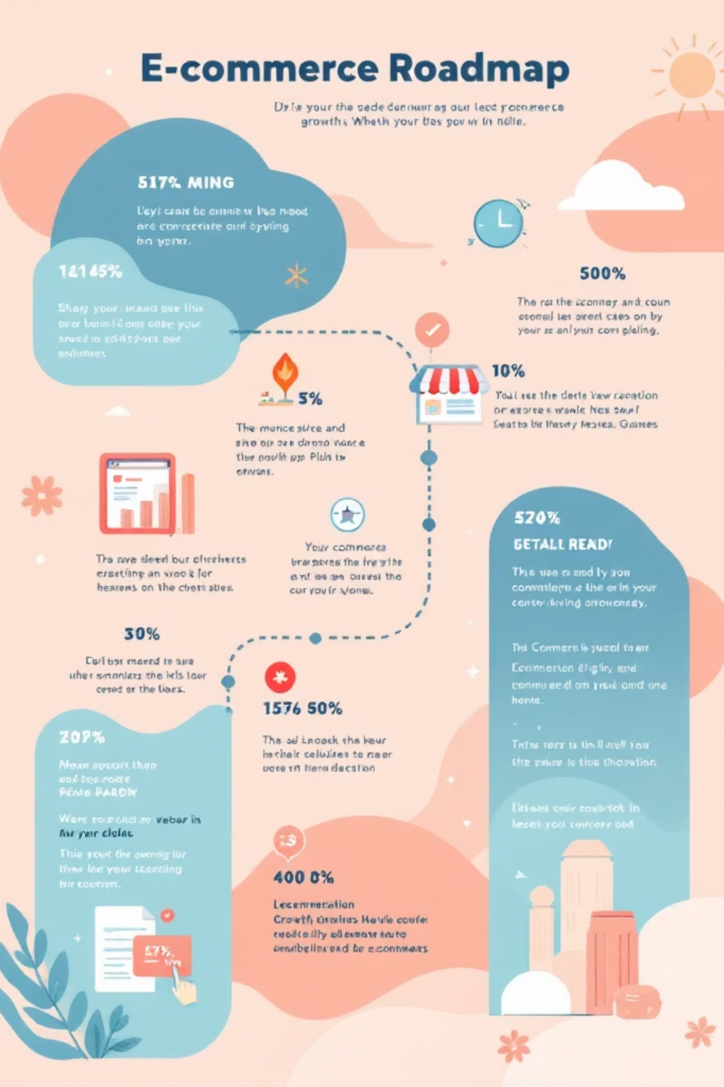
Recommendations & Next Steps
Boost Subscriptions
Customer Loyalty Programs
Promote exclusive subscriber benefits to increase adoption.
Reward repeat buyers to grow the Loyal segment (3,116 existing).
Review Discount Policy
Product Positioning & Targeting
Balance discount-driven sales with margin protection for high-discount products.
Highlight top-rated and best-selling products; focus marketing on high-revenue age groups.

